Slide 1
Week 2 Learn Tools
Download files from here:
http://gg.gg/mvclab-tutorial-week-2
Author ：Sheng-Hao Liao (frakw)
Date ：2024-05-01
Email ：frakwu@gmail.com

Slide 2
Outline
01
SSH and Git
02
Anaconda and Docker
03
Label Training Data
04
Useful knowledge

Slide 3
01 SSH and Git

Slide 4
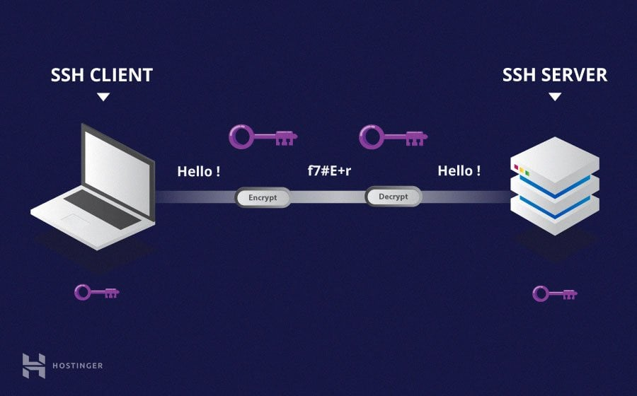
SSH Introduction
SSH : Secure Shell Protocol
Asymmetric encryption
Public key for encrypt, private key for decrypt
Client need
Your private key
Server’s public key
Server need
Your private key
Server’s private key
Unable to obtain content from this communication

Slide 5
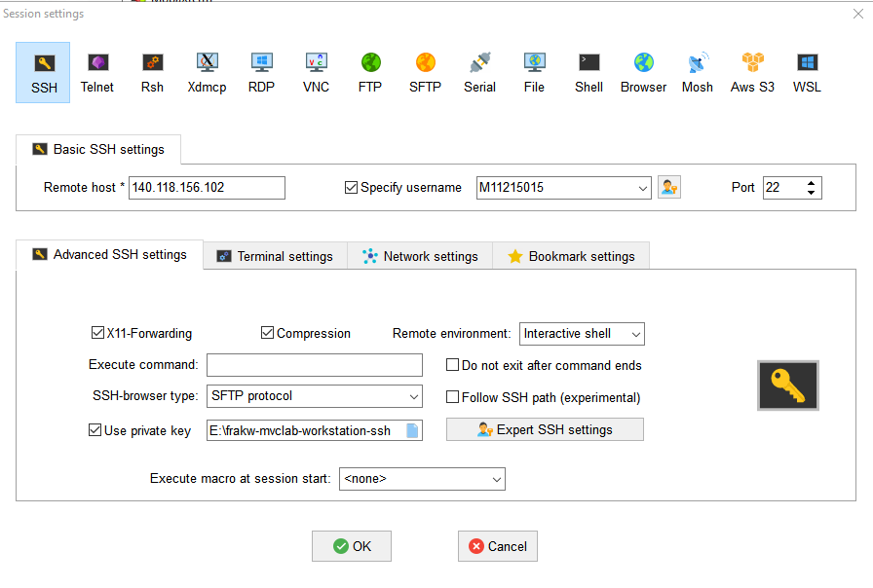
SSH software
If you use windows
MobaXterm (support a lot of protocol)
Two Authentication Way
Password
SSH-Key (more safety)
Ssh require
Host ip : <server_ip>
Username
Private key / Password
OpenSSH
sudo apt install openssh-client

Slide 6
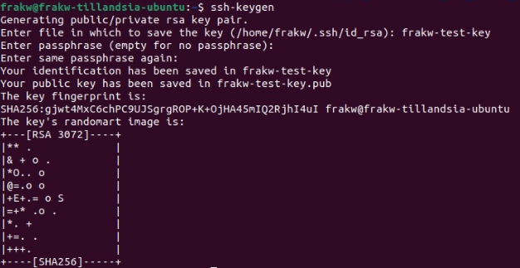
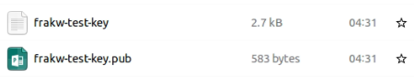
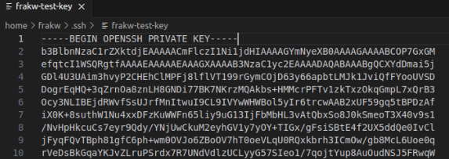
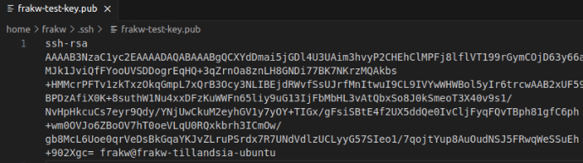
SSH key gen and add
Add a key to your openssh-client
cd ~/.ssh
ssh-keygen
Enter key filename : frakw-test-key
Enter passphrase (more security)
ssh-add frakw-test-key
If key is come from another computer
chmod 600 frakw-test-key
ssh-add frakw-test-key

Slide 7
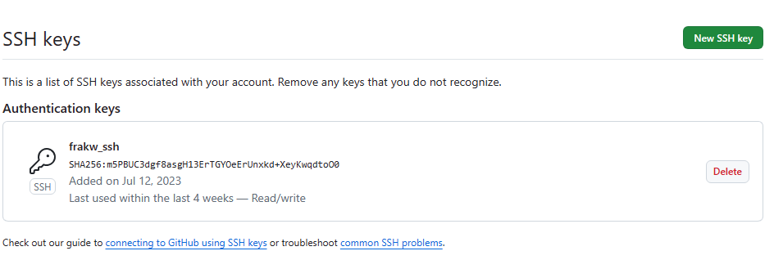
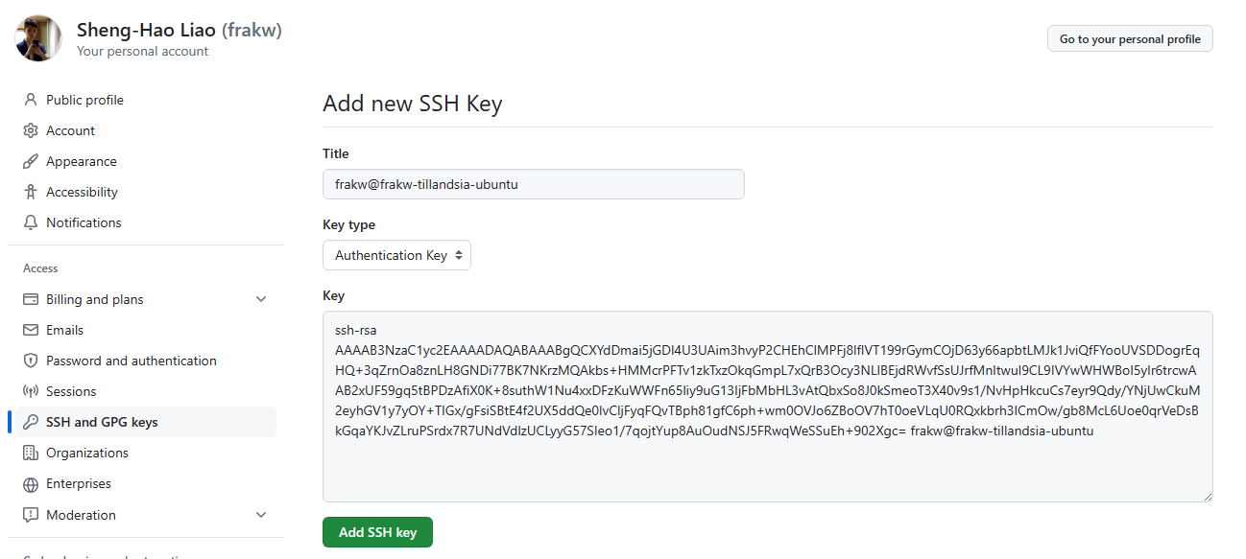
SSH GitHub
Setting -> SSH and GPG keys -> New SSH key

Slide 8
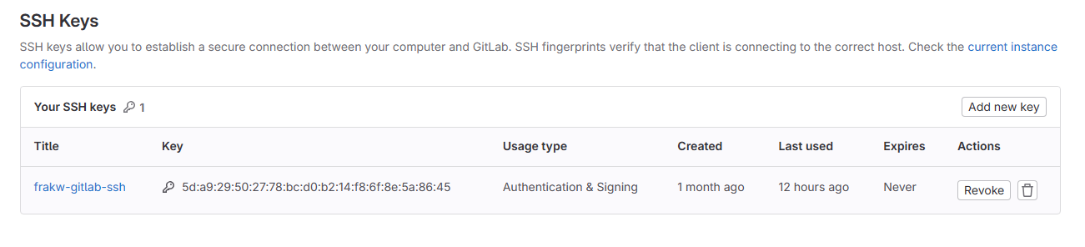
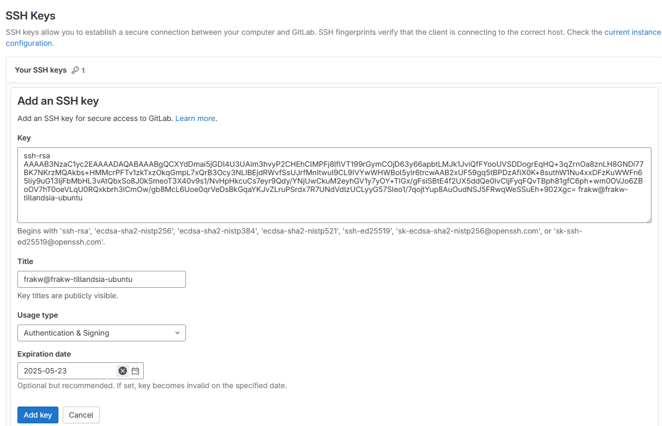
SSH Gitlab
Setting -> SSH keys -> Add new key
Click to disable expiration

Slide 9
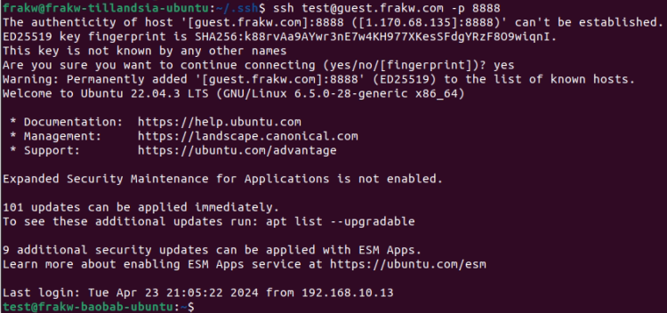
Classwork 1 : SSH to my computer
Add attachment file ssh_test key to your OpenSSH client
ssh test@guest.frakw.com –p 8888

Slide 10
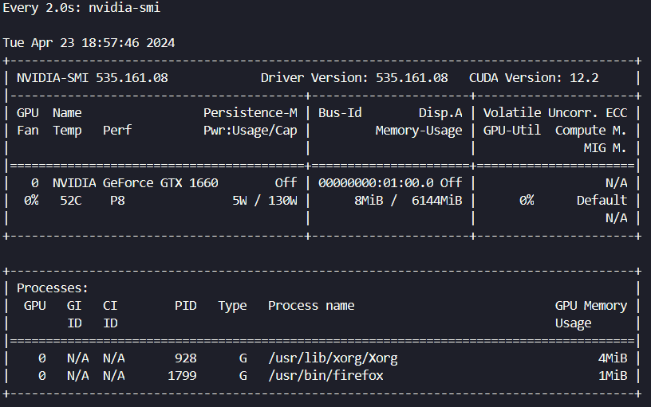
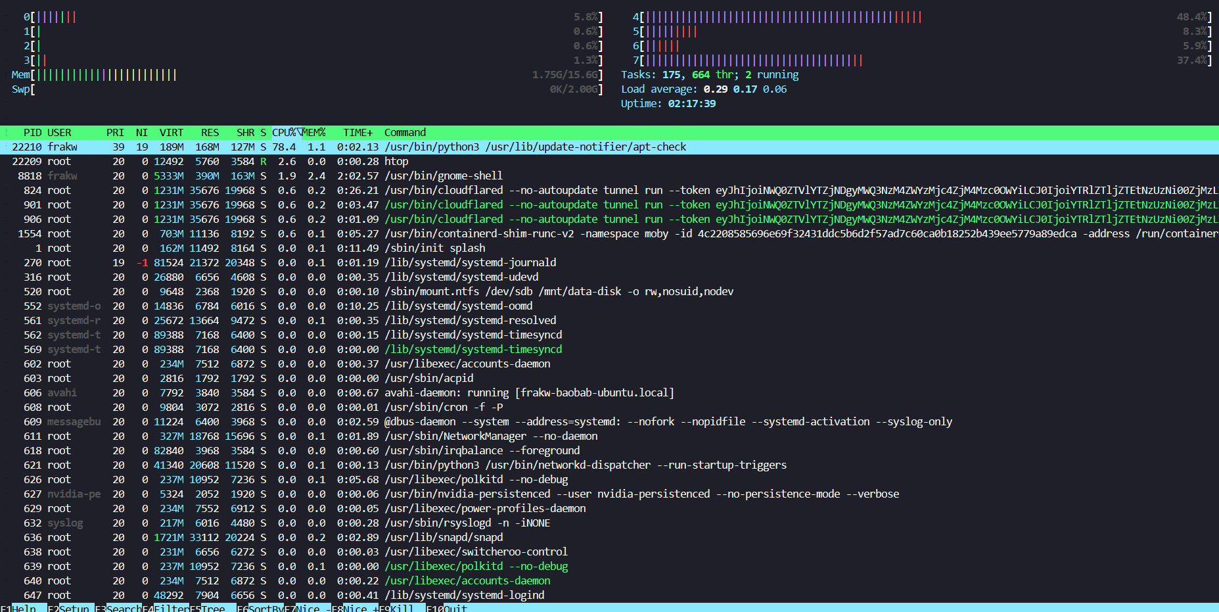
Monitor the server resources
watch nvidia-smi
htop

Slide 11
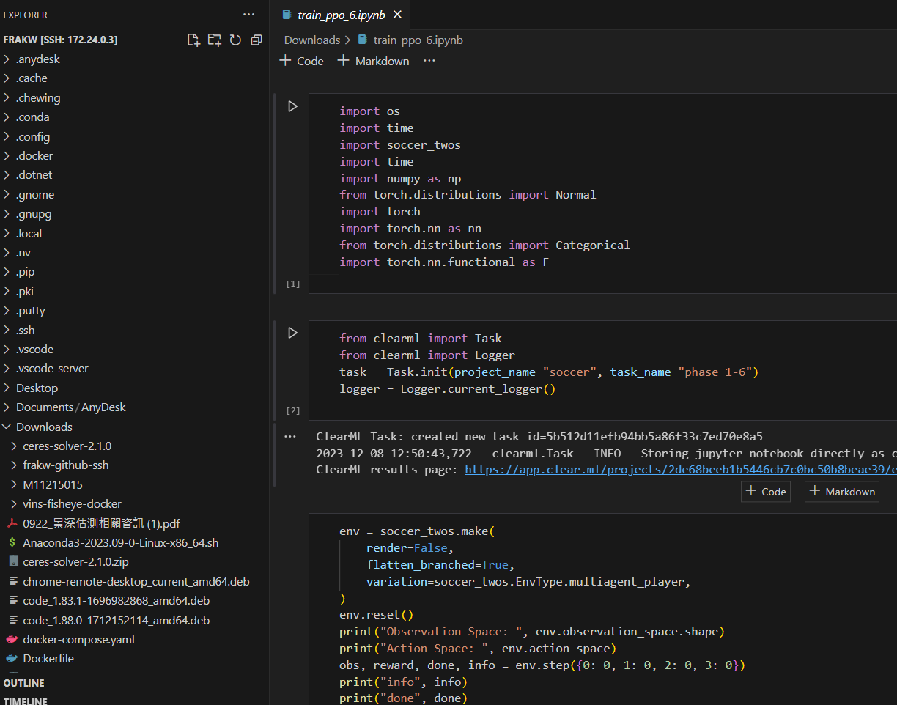
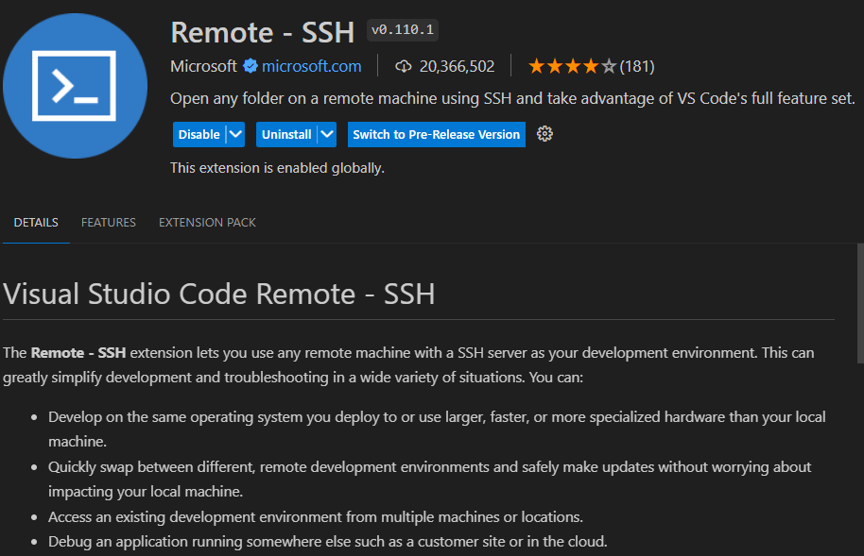
VSCode SSH extension
172.24.0.3 come from vpn
(LAN IP range)

Slide 12
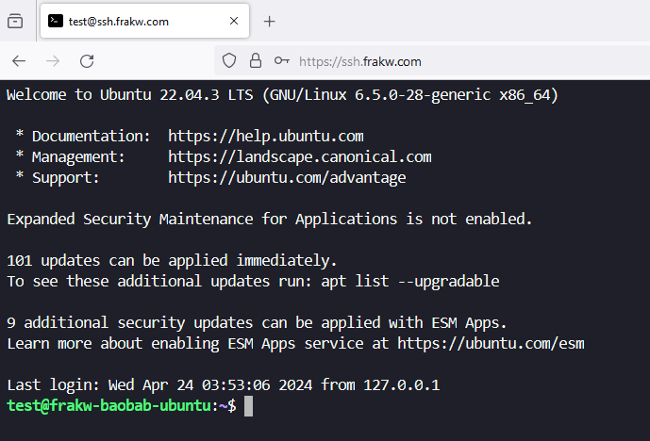
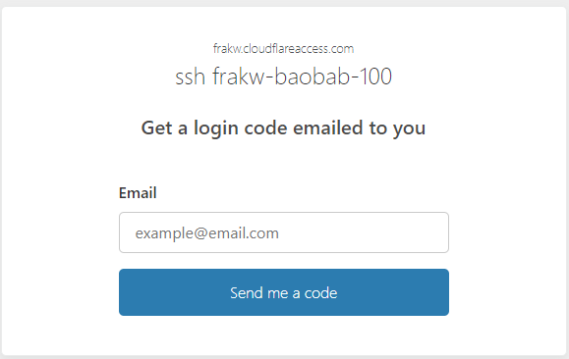
Browser-rendered terminal
https://ssh.frakw.com/
User : test
Pass : mvclab
Tutorial : Cloudflare tunnel SSH
You must own a domain name

Slide 13

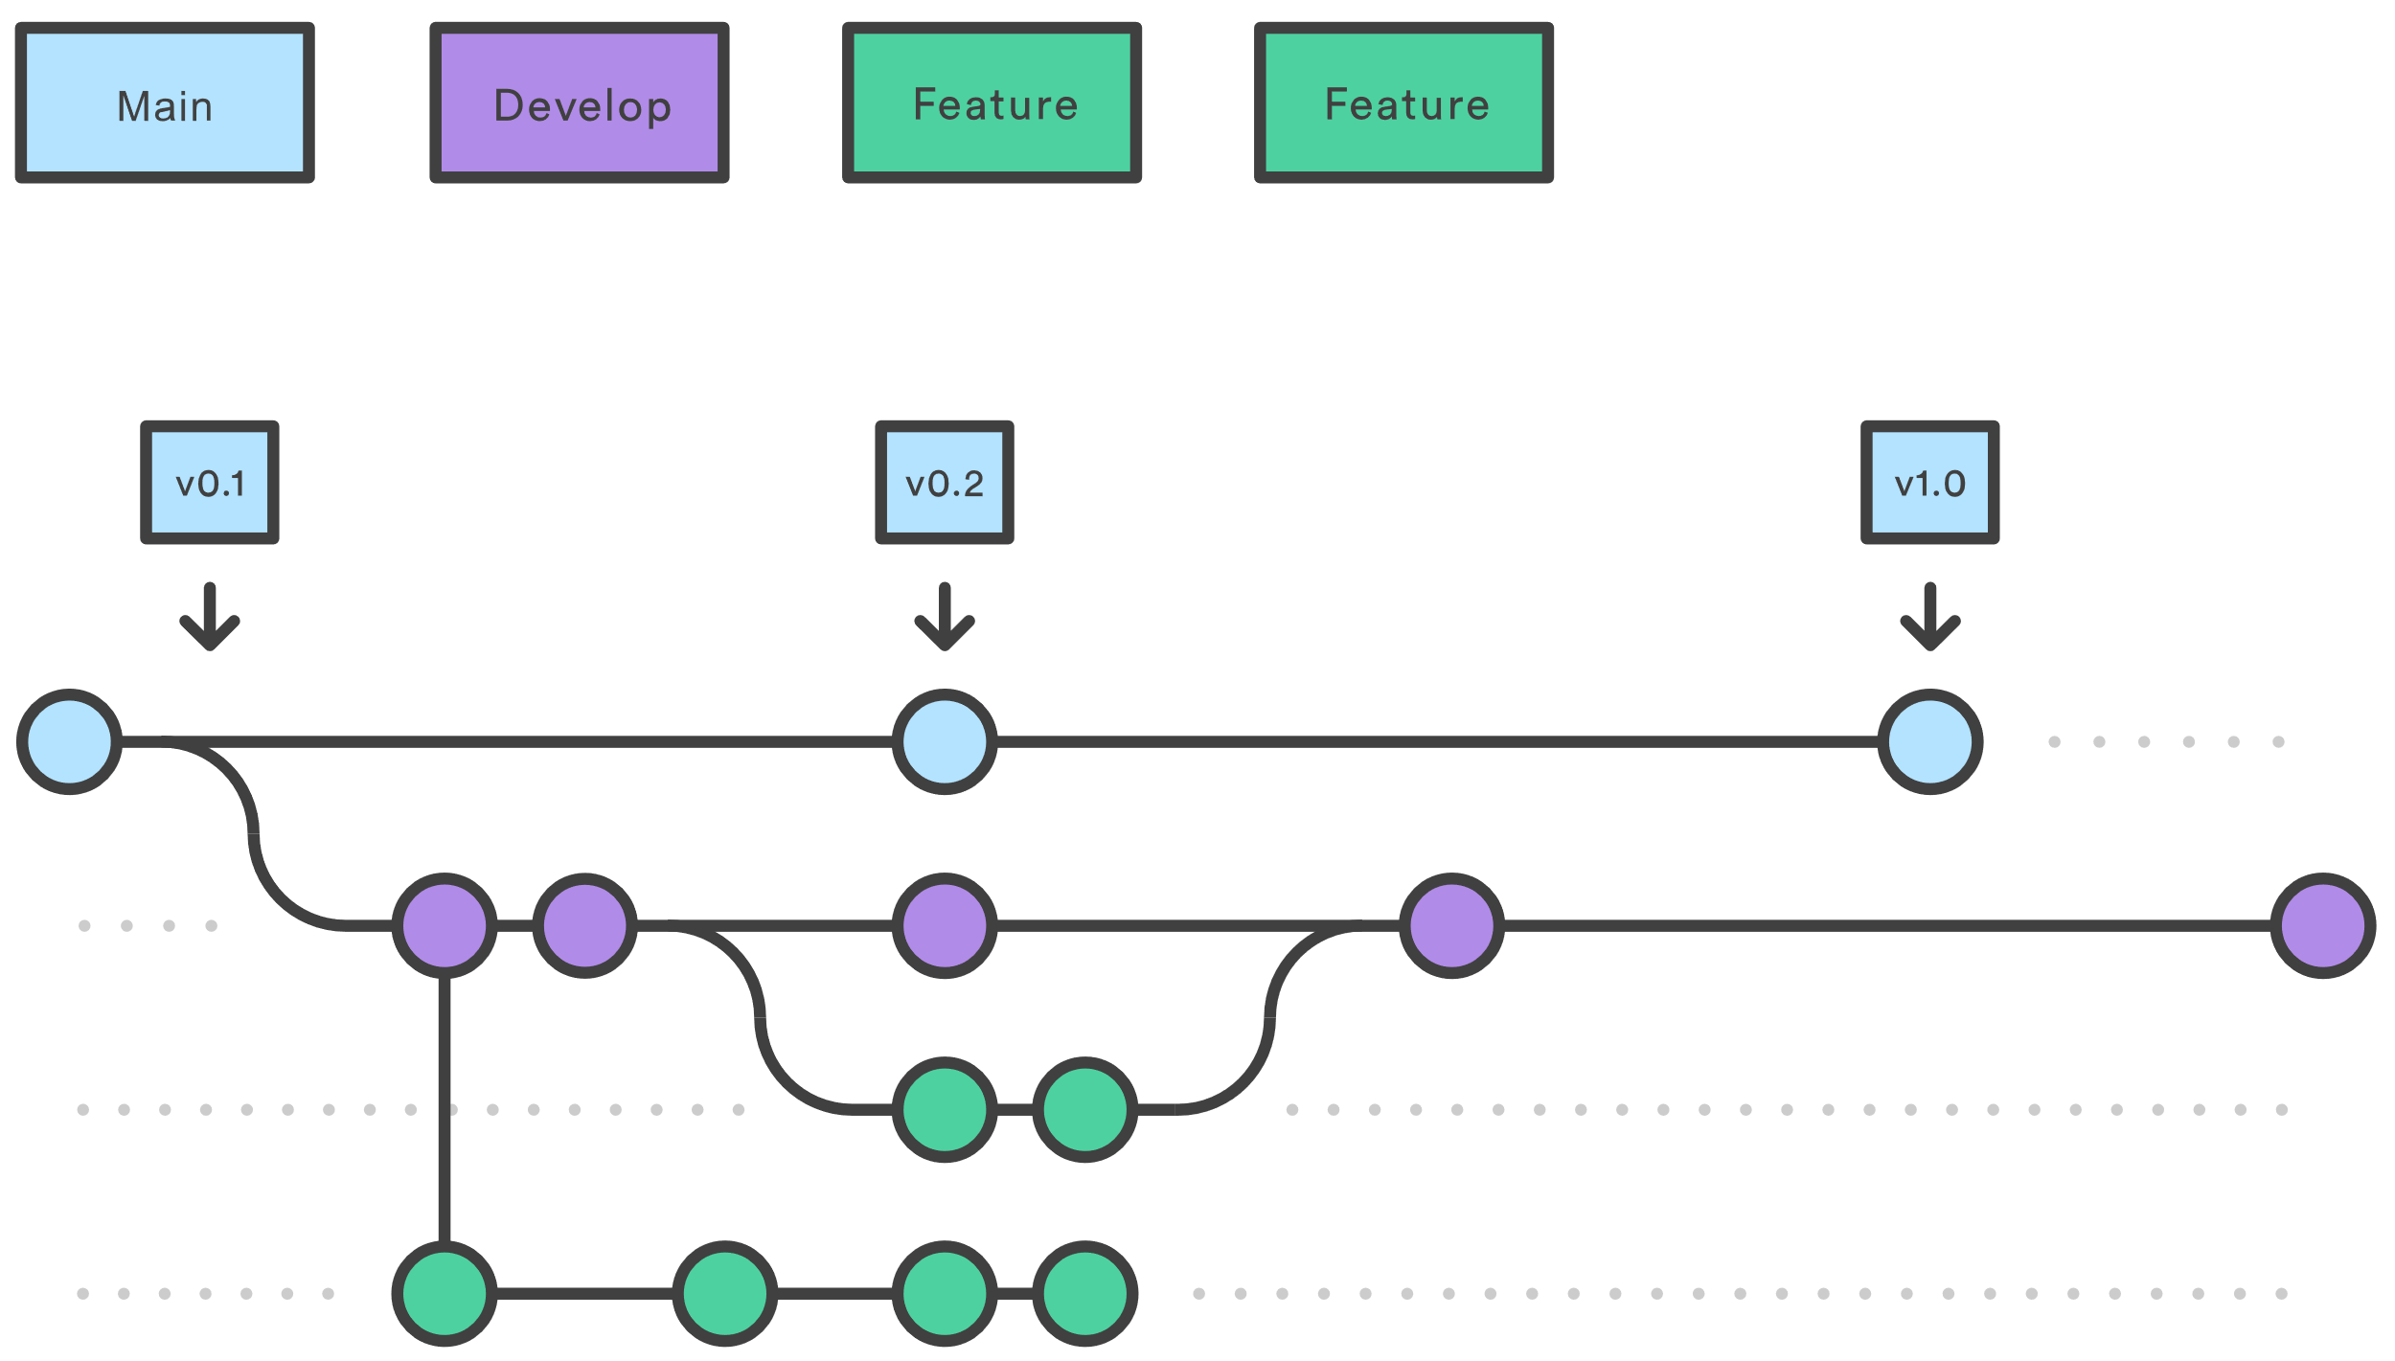
Git Introduction
Version control
Multi-person collaboration
Sync your progress to different location
Install Git
sudo apt install git

Slide 14

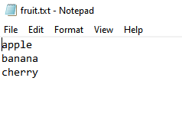
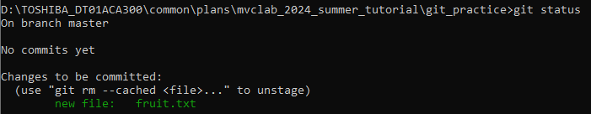
Git Basic (1)
mkdir git_practice
cd git_practice
git init
Add fruit.txt
git add . (add all change to current commit)
git status

Slide 15
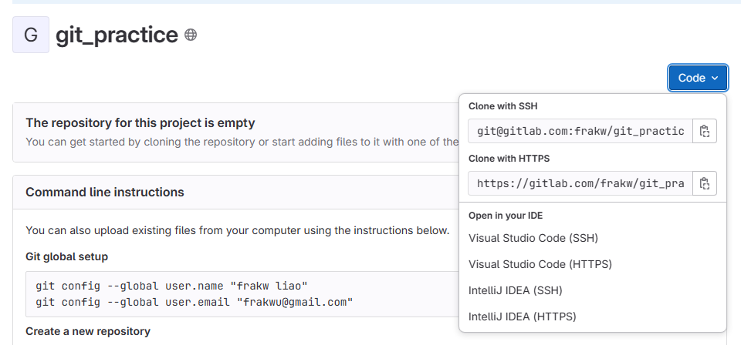
Git Basic (2)
git commit –m "I add fruit.txt XDDDD"
git status
Create repo in gitlab
git remote add origin git@gitlab.com:frakw/git_practice.git

Slide 16
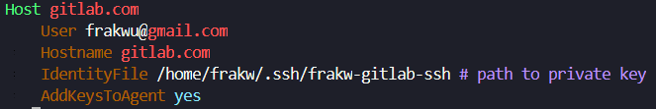
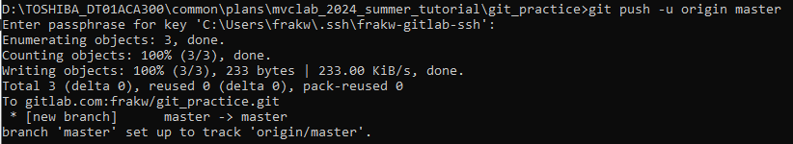
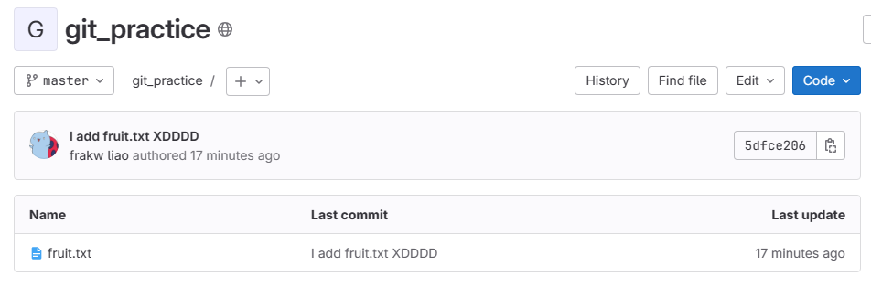
Git Basic (3)
Modify ssh config (/home/username/.ssh/config)
Add following :
git push -u origin master
Check result in gitlab website

Slide 17
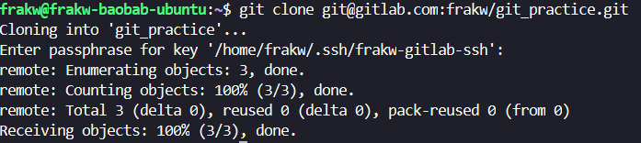
Git Basic (4)
On another computer:
git clone git@gitlab.com:frakw/git_practice.git
git pull -> get new commit from remote
git branch food -> create a branch called food from current commit (not including uncommit changes)
git checkout food -> switch to food branch

Slide 18
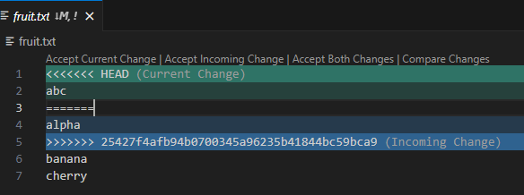
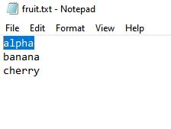
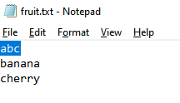
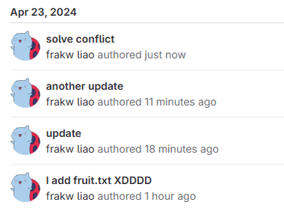
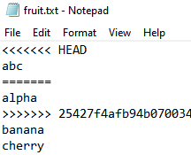
Resolve conflict
Computer A
Computer B
When multiple commits edit the same line in file
Use VSCode to select
Commit & push
Commit but not pushed
git pull

Slide 19
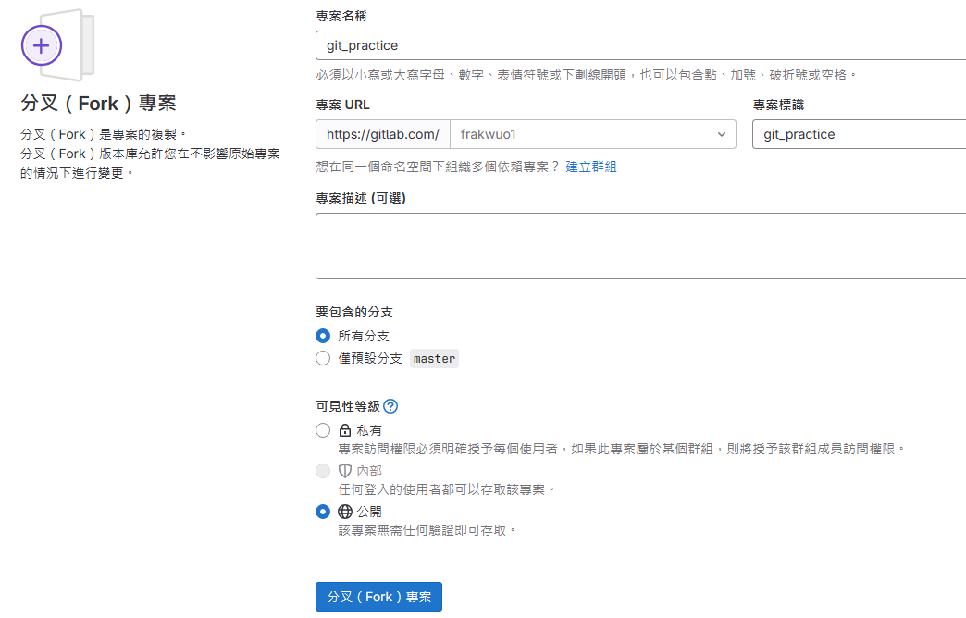
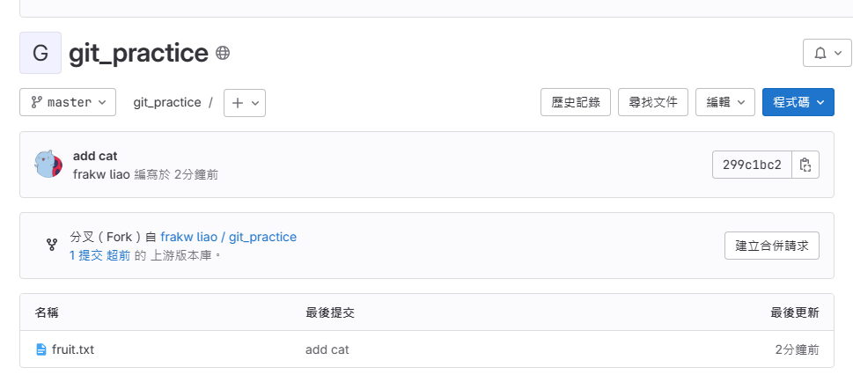
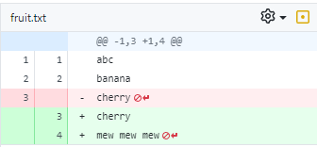
Git pull request (PR)
Fork repo to your own account
Commit and push changes to your repo

Slide 20
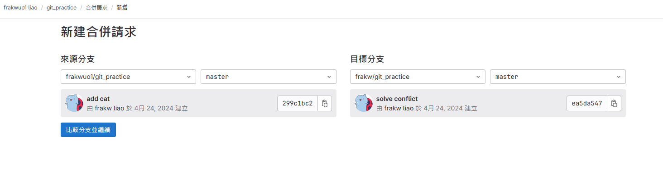
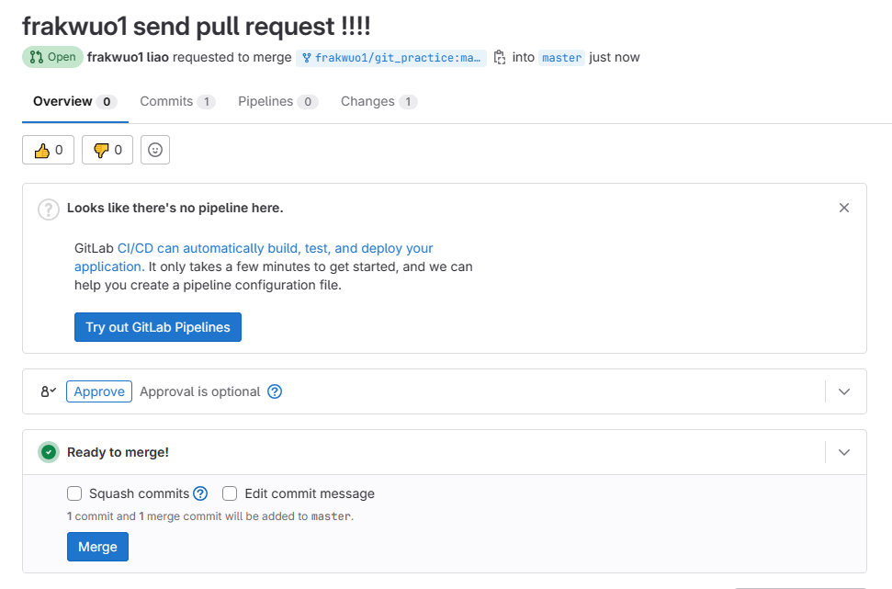

Git pull request (PR)
Create merge request
Frakw receive the request and accept

Slide 21
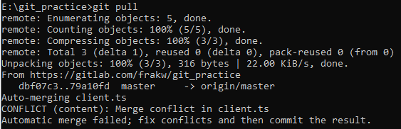

Homework 1 : resolve conflict and PR
Go to attachment folder git_practice repo then git pull will encounter conflict, solve it!
Fork my repo and set remote to your fork repo https://gitlab.com/frakw/git_practice
Commit above change and pull request to my repo
Paste some screenshot in README.md

Slide 22
02 Anaconda and Docker

Slide 23

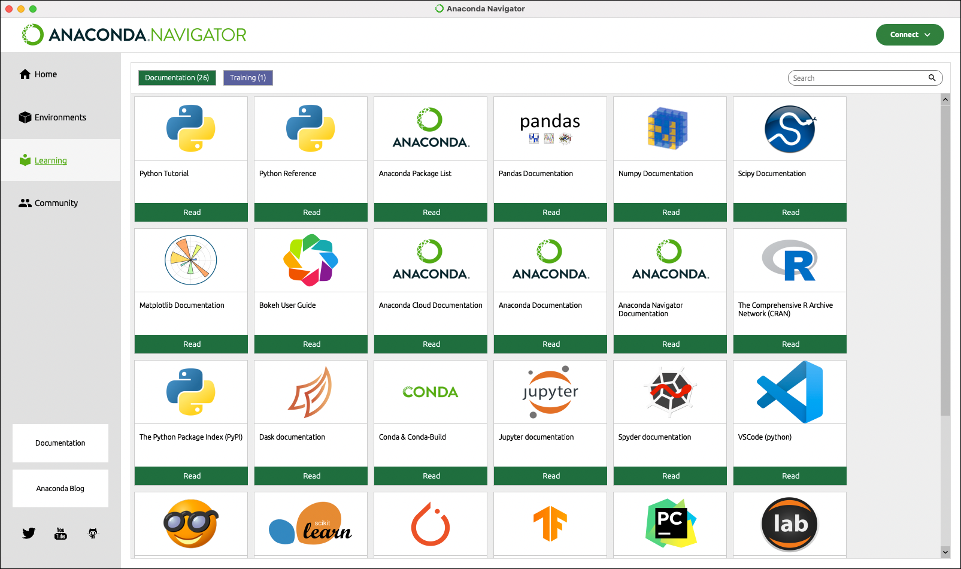
Anaconda introduction
Python virtual environment
Easy to manage python packages
Make python more compatibility
I usually create a new conda environment for each project to avoid package conflict

Slide 24
Anaconda basic (1)
Installation
Download : https://www.anaconda.com/download/
bash <conda-installer-name>-latest-Linux-x86_64.sh
conda --version to check if successful install
Create environment
conda create --name resnet18 python=3.10
Rename environment
conda rename -n resnet18 resnet34
Remove environment
conda env remove --name resnet34

Slide 25
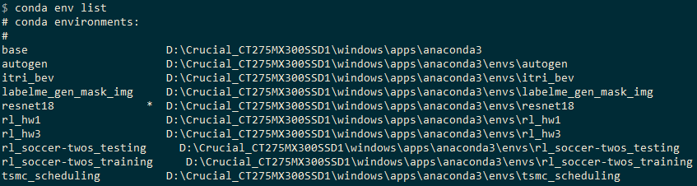
Anaconda basic (2)
Enter environment
source activate resnet18
Install package
conda install <package_name>
Pip vs conda install ?
https://www.reddit.com/r/Python/comments/w564g0/can_anyone_explain_the_differences_of_conda_vs_pip/
I recommend use pip
List all environment
conda env list

Slide 26
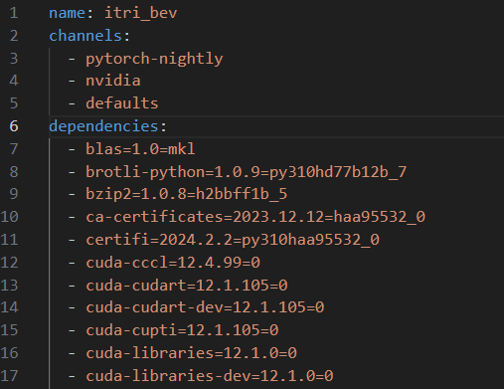
Anaconda basic (3)
Export environment to yaml file
source activate <env_name>
conda env export > env.yaml
Import env from yaml file
conda env create -f env.yaml
Update package
conda update <package_name>
conda update --all

Slide 27
Anaconda vs Docker
Pure python program without any external dependency => anaconda
CUDA family
https://www.zhihu.com/question/506867139
https://blog.csdn.net/qq_41094058/article/details/116207333
cuda-toolkit support in anaconda, but nvcc compiler is not
So use docker if you have CUDA code
Difference
Anaconda is python-level virtual environment
Docker is system-level virtual environment
With large scale applications ? (lots of VM, computer working together)
Kubernetes(K8S)

Slide 28
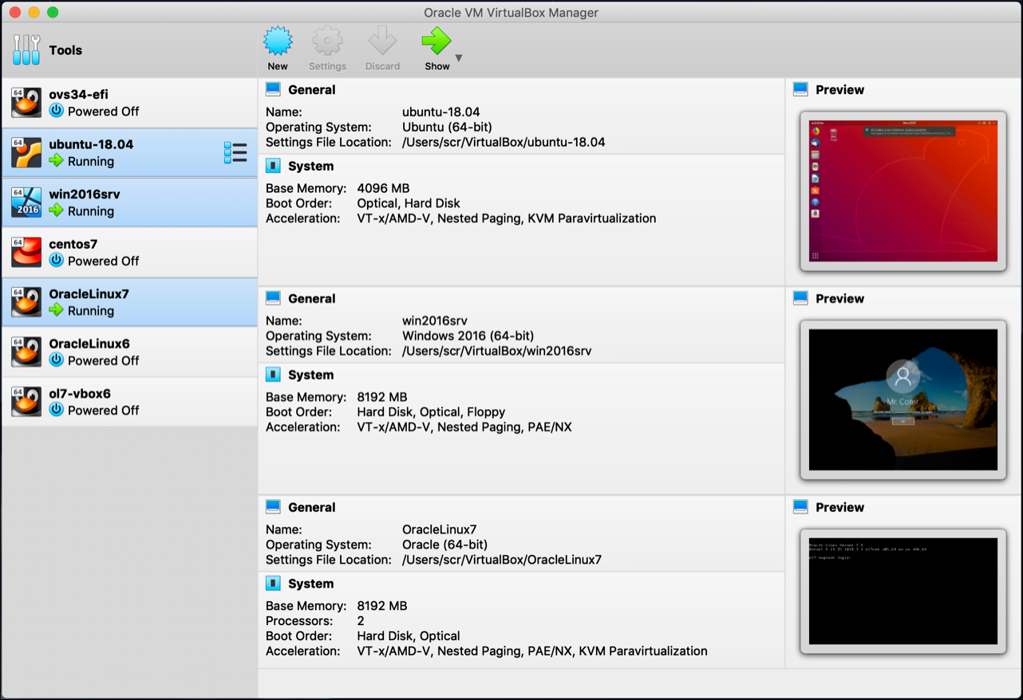
VM introduction
Hypervisor : a software or OS that runs virtual machines
Software Engine
VMware Work Station, Virtual Box, Hyper-V, QEMU, KVM...
OS Engine
Proxmox, VMware ESXi, Windows Server, Unraid...

Slide 29

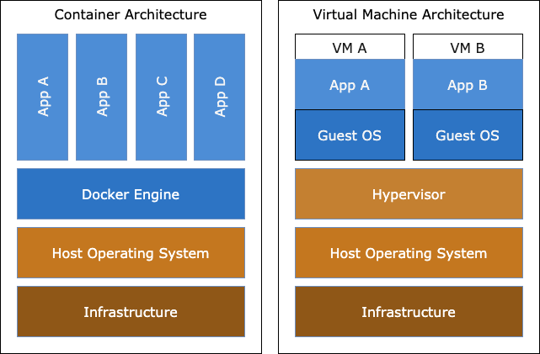
Docker introduction
Linux-based virtual operating system (not VM)
Each virtual OS called container
VM vs Container
VM run a complete OS
Container share Linux kernel with host OS
That is why container faster than VM
What does docker do:
Resources separation
You can think of it simply as separating the file system which contain the develop environment
Pros & Cons
Fast and quick deploy
Security issues (Easy to broke host OS)

Slide 30
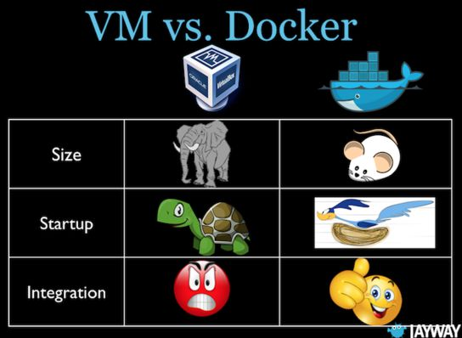
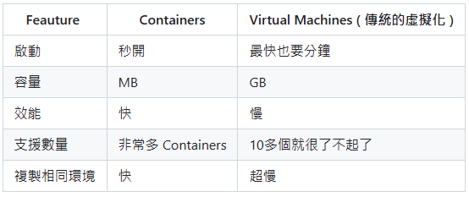
VM vs Container

Slide 31
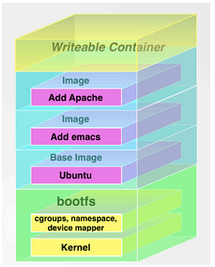
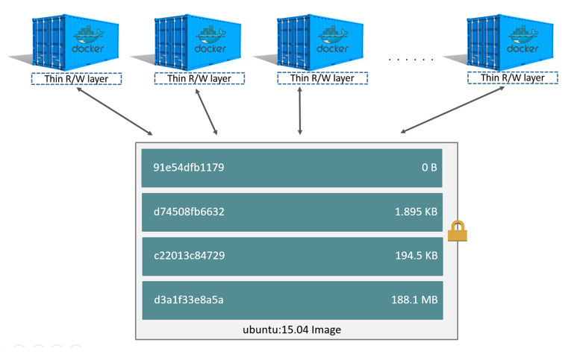
Docker architecture
Docker image : Read-Only stack layers
Docker container : writable layer on top of image
You can think as : image -> executable file, container -> application instance (run inside memory)
Containers
Image

Slide 32
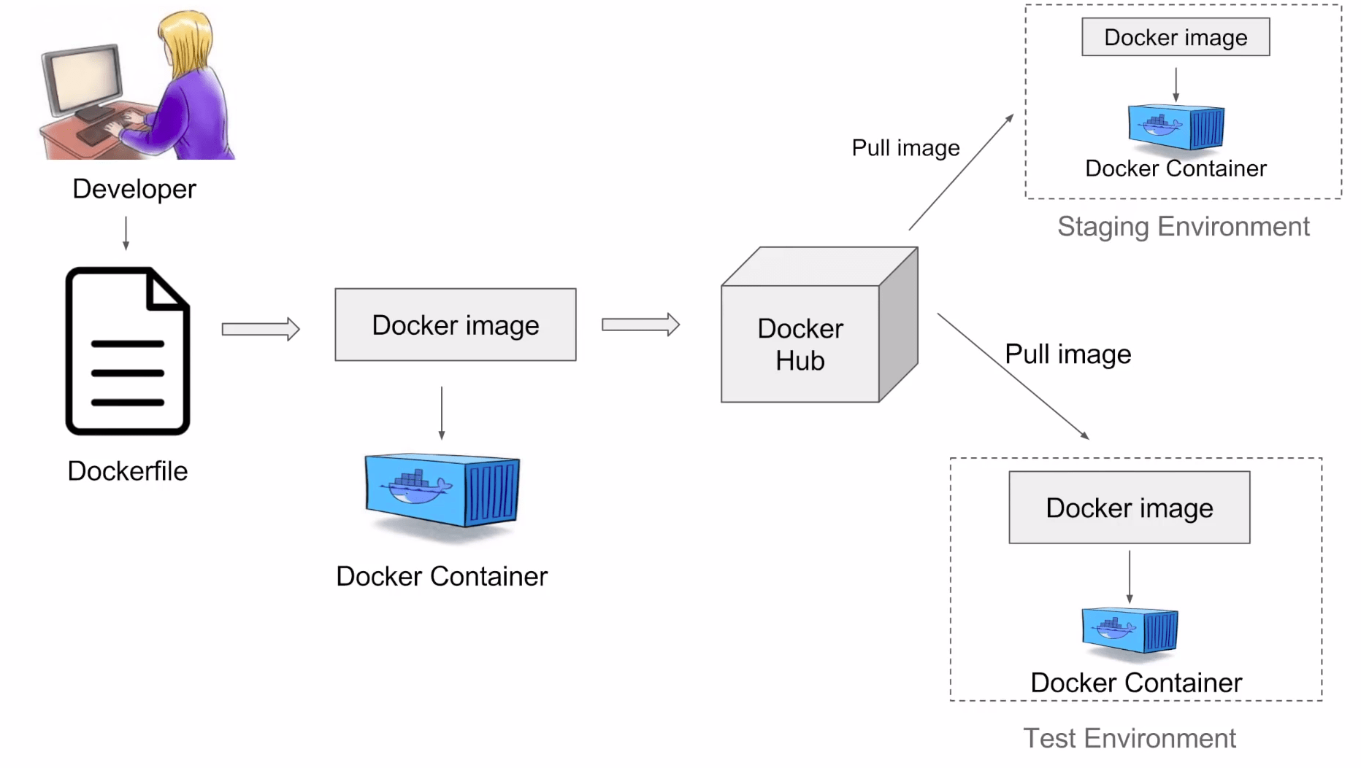
Docker deployment
Use Dockerfile to build your customized OS as image
EX: ubuntu that install python and vim
Push image to docker registry (store docker images)
In another devices like developer’s computer or tester’s computer or main server
Pull docker image down
Start docker image to container

Slide 33
Docker workflow
docker pull => Download an image from a registry
docker build => Build image from a Dockerfile
docker run => Create and run a new container from an image

Slide 34
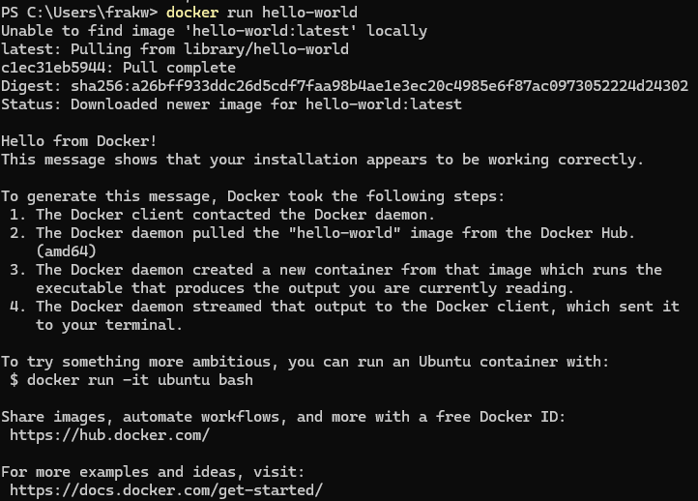
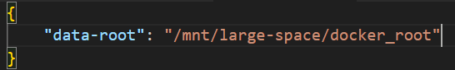
Docker install
curl -fsSL https://get.docker.com/ | sh
Docker without sudo
sudo groupadd docker
sudo usermod -aG docker $USER
docker run hello-world
Move docker to large disk
docker store data inside /var/lib/docker
Move to /mnt/large-space/docker_root
sudo service docker stop
Add "data-root" value inside /etc/docker/daemon.json
sudo rsync -aP /var/lib/docker/ /mnt/large-space/docker_root
sudo service docker start

Slide 35
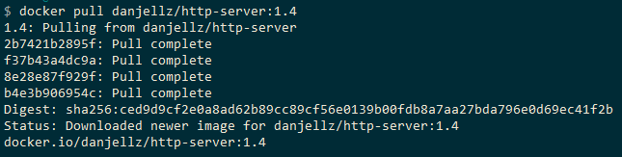
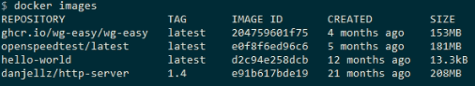
Docker pull
docker pull <docker帳號>/<image名稱>:<image_tag>
EX : docker pull danjellz/http-server:1.4
If tag not specified default is ”latest”
docker images : list images

Slide 36

Docker naming system (1)
Image use tag as their name and can own multiple tag same time

Slide 37

Docker naming system (2)
The container can have a name. If not assigned, docker will assign a random name.

Slide 38
Docker build
Build an image from a Dockerfile
docker build --file /path/to/Dockerfile --tag frakw/resume_website:x64_1.0
--file : specify the Dockerfile you want to build
--tag : add a tag to the target image

Slide 39


Dockerfile
Dockerfile https://docs.docker.com/reference/dockerfile/
FROM : create a new build stage from a base image (usually come from registry)
WORKDIR : set working directory
ENV : set environment variables
RUN : execute build commands
COPY/ADD : copy files and directories into image [Link]

Slide 40

Docker run
Create and run a new container from an image
docker run --name my-website danjellz/http-server:latest
--name : assign a name to the container
-d : detach mode
--device : add a host device to the container (webcam etc...)
--restart : restart policies [Link]
--rm : automatically remove the container when it exits
-v : bind mount a volume
docker ps : show running containers
--all : show all containers

Slide 41

Classwork 2 : Launch static website
tar zxvf threejs.tar.gz
cd threejs
docker run --rm --name threejs_app -p 8080:8080 -v $(pwd):/public danjellz/http-server
http://localhost:8080/

Slide 42



Docker compose
Run multiple container application
Simplify the docker run command
Part of CI/CD
Useful tool convert docker run command into docker-compose.yaml : composerize.com
Can work with Dockerfile

Slide 43

Classwork 2 : Launch your first docker app
Web-based server monitor
cd glances
docker compose up -d
http://localhost:61208/

Slide 44

Docker exec
Execute a command in a running container
docker exec -it itri-bev-container /bin/bash
-it : interactive(-i) combine pseudo-TTY(-t)
/bin/bash : execute Linux shell

Slide 45


Docker commit, save, load
Docker commit : create a new image from a container's changes
docker commit itri-bev-container frakw/itri-bev-image:latest
Docker save : export image to a .tar file
docker save frakw/itri-bev-image:latest > itri-bev-image.tar
Docker load : load image from .tar file
docker load < itri-bev-image.tar

Slide 46

Docker push
Upload image to docker registry (docker hub)
docker login
docker push frakw/itri-bev:x64

Slide 47

Container GUI manager
Portainer : https://www.portainer.io/
Installation
docker pull portainer/portainer
docker run -d -p 9000:9000 -v /var/run/docker.sock:/var/run/docker.sock --restart=always --name prtainer portainer/portainer
http://localhost:9000

Slide 48


Homework 2 : write Dockerfile and docker-compose.yaml
Use docker compose up -d can automatically build image and run a container
python detect.py --view-img --nosave --weights yolov5x.pt --source video/argoverse/argoverse.mp4 --run-liteMono --run-bev --classes 2 5 7
Hint : nvidia-docker2, xhost, nvidia ngc

Slide 49
03 Label Training Data

Slide 50

awesome-data-labeling
https://github.com/HumanSignal/awesome-data-labeling

Slide 51


labelme
Install : https://github.com/labelmeai/labelme/releases/tag/v5.4.1

Slide 52

labelme (1)

Slide 53

labelme (2)

Slide 54

labelme (3)
Draw the polygon of the glue range
Label polygon name “glue”

Slide 55



labelme (3)
Ctrl + S
Save as json file, and label next glue image

Slide 56


labelme (5)
After label all image execute labelme_gen_mask_img.py
python labelme_gen_mask_img.py

Slide 57


CVAT
Computer Vision Annotation Tool : https://www.cvat.ai/

Slide 58

Dataset
Train data format：
Use COCO dataset format, contain images, annotations and categories。
images | annotations | categories
image{ "id": int, "width": int, "height": int, "file_name": str, "license": int, "flickr_url": str, "coco_url": str, "date_captured": datetime, } | annotation{ "id": int, "image_id": int, "category_id": int, "segmentation": RLE or [polygon], "area": float, "bbox": [x,y,width,height], "iscrowd": 0 or 1, } | categories{"id": int, "name": str, "supercategory": str, }

Slide 59

CVAT (1/8)
Register CVAT account
Create a new project -> car_segmentation

Slide 60

CVAT (2/8)
Add labels and follow the order：
person
motorcycle
bicycle
car
truck
bus
motorcycle rider
bicycle rider

Slide 61



CVAT (3/8)
Create new task and upload car images
Click “Open”
Tool list
Change Picture
Annotation result
Parameter adjust

Slide 62

CVAT (4/8) Draw polygon

Slide 63

CVAT (5/8) AI Detectors

Slide 64

CVAT (6/8) AI Interactors

Slide 65

CVAT (7/8) OpenCV Drawing

Slide 66

CVAT (8/8) Export
Menu -> Export job
COCO 1.0

Slide 67

Homework 3 : use CVAT to label dataset

Slide 68
Training
https://hackmd.io/f2jeS3q6QVWiwxcSAnDmkg?view

Slide 69
04 Useful knowledge

Slide 70

Useful tools (1)
Crontab
Schedule tasks (backup, upload, reboot...)
Use https://crontab.guru/ to check
Tmux
terminal multiplexer
Multiple terminal in one window

Slide 71


Useful tools (2)
Alias
Simplify the commands
Usually put in ~/.bashrc
Bash
Like windows .bat file
Use script to execute commands

Slide 72


Useful tools (3)
Iperf
Local network speed test
Rclone
Access cloud storage using cli

Slide 73


Remote desktop
Remmina
RDP
Unsafe protocol
Faster, low delay
VNC
VPN + RDP is the best

Slide 74


VPN tools
Tailscale
Good
But ip is hard to remember
Zerotier
Wireguard (require port forwarding)
Better than NTUST VPN

Slide 75


Proxmox Virtual Environment
VM, container hypervisor
Download : https://www.proxmox.com/en/downloads

Slide 76


OpenMediaVault
NAS system
Download : https://www.openmediavault.org/download.html

Slide 77


Nextcloud
Self host Cloud Storage
https://nextcloud.com/

Slide 78

Optional homework : share your own cloud
You can use ngrok : https://ngrok.com/
Example : https://nextcloud.frakw.com/s/TRCeDockjHDXHDa

Slide 79


Optional homework : deploy you CV on website using GitHub Pages
cd resume
Edit resume.json
npm install hackmyresume@1.8.0 –g
npm install jsonresume-theme-kendall
hackmyresume build resume.json -t node_modules/jsonresume-theme-kendall

Slide 80

Optional homework : deploy you resume on website using GitHub Pages
GitHub Page is free!!!
Example : https://frakw.github.io/
https://jsonresume.org/schema/

Slide 81
Useful search website
Scholar search
https://scholar.google.com.tw/?hl=zh-TW
Newest paper
https://arxiv-sanity-lite.com/
Deep learning field paper
https://deeplearn.org/
https://www.connectedpapers.com/
AI read paper
https://www.chatpdf.com/
https://www.explainpaper.com/
Download non-free paper
https://sci-hub.se/

Slide 82
Thank you for your attention!

Slide 83
Reference
SSH Tutorial: What is SSH, Encryptions and Ports (hostinger.co.uk)
MobaXterm free Xserver and tabbed SSH client for Windows (mobatek.net)
SSH · Cloudflare Zero Trust docs
Gitflow Workflow | Atlassian Git Tutorial
Git & GitHub 教學手冊 - Git 環境教學 | W3HexSchool
Installing on Linux — conda 24.3.1.dev62 documentation
https://www.reddit.com/r/Python/comments/w564g0/can_anyone_explain_the_differences_of_conda_vs_pip
conda还是docker？ - 知乎 (zhihu.com)
一文讲清楚CUDA、CUDA toolkit、CUDNN、NVCC关系-CSDN博客
Bitovi Academy - What is Docker
Install Docker Engine on Debian | Docker Docs
Docker overview | Docker Docs
twtrubiks/docker-tutorial: Docker 基本教學 - 從無到有 Docker-Beginners-Guide 教你用 Docker 建立 Django + PostgreSQL 📝 (github.com)
Docker and Kubernetes | How are they better together? (k21academy.com)

Slide 84
Reference
Docker Container. Docker containers represent a… | by MrDevSecOps | Medium
How to move docker data directory to another location on Ubuntu | Guguweb
Dockerfile reference | Docker Docs
Dockerfile 中的 COPY 与 ADD 命令 - sparkdev - 博客园 (cnblogs.com)
docker run | Docker Docs
CI/CD - 維基百科，自由的百科全書 (wikipedia.org)
Docker Compose overview | Docker Docs
Composerize
danjellz/http-server - Docker Image | Docker Hub
Docker Tutorial - Docker Commit (Create image with container) Save(Backup) Load(Restore) - Part15 (youtube.com)
https://www.portainer.io/
https://github.com/HumanSignal/awesome-data-labeling
https://github.com/labelmeai/labelme
CVAT
Download Proxmox software, datasheets, agreements

Slide 85
Reference
https://www.openmediavault.org/download.html
https://nextcloud.com/
https://ngrok.com/
Markdown 語法說明
https://github.com/hacksalot/HackMyResume
https://jsonresume.org/schema/
GitHub Pages | Websites for you and your projects, hosted directly from your GitHub repository. Just edit, push, and your changes are live.
https://scholar.google.com.tw/?hl=zh-TW
https://arxiv-sanity-lite.com/
https://deeplearn.org/
https://www.connectedpapers.com/
https://www.chatpdf.com/
https://www.explainpaper.com/
https://sci-hub.se/

Slide 86
Reference
Master the Cron Scheduling Syntax | Blog (contabo.com)
https://larrylu.blog/tmux-33a24e595fbc
bash - Renaming files in a folder to sequential numbers - Stack Overflow
如何使用 iPerf 測試 TP-Link 路由器的速度
Remote desktop client with RDP, SSH, SPICE, VNC, and X2Go protocol support. – Remmina
Tailscale · Best VPN Service for Secure Networks
ZeroTier | Global Area Networking
WireGuard: fast, modern, secure VPN tunnel

